Slide 1



Real-Time Sample Rate Converter for High-Quality Audio Signal Processing
End-of-study Project
Gabriel Suc
Supervisors
Pablo Martinez-Nuevo Henrik Lund Jensen
Sven Ewan Shepstone Geoff Martin
Prof. Matthieu Guerquin-Kern
September 25 , 2018

Slide 2
PLAN
Motivation
Problem Formulation
Approaches
Results
Future Work
2/25

Slide 3
Motivation
• Modern audio interconnection of systems operating at different rates
• Sample Rate Conversion is the key operation
• Still one of the weakest building blocks
• Limits of open-sources projects (GStreamer): audible artifatcs
• Limits of third-party proprietary (Audio Weaver): not have full control
3/25
Notes:
Why this project?
Modern audio/visual processing chains consist of an interconnection of systems operating at different rates
Thus, SRConversion is the key operation that makes this interconnection possible
Despite being a crucial, and widely used operation of many discrete-time processing system, it’s still one of the weakest building blocks
Open-source software implementations of SRConversion used in B&O’s products (E.g.: GStreamer) create audible artifacts that do not meet the performance standards of B&O’s audio quality
Moreover, third-party proprietary implementations like Audio Weaver do not provide full support for the variety of sampling rates that are required in B&O’s systems + no control over its design and implementation => not viable to evaluate and accommodate its performance to our needs

Slide 4
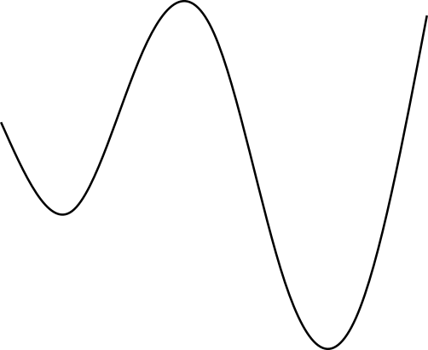
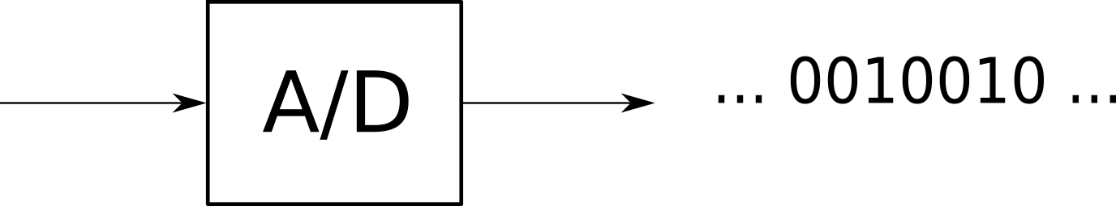
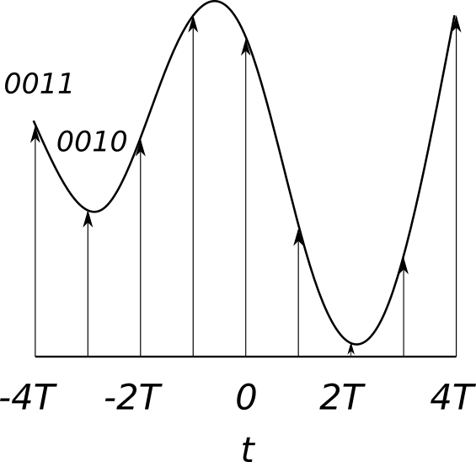
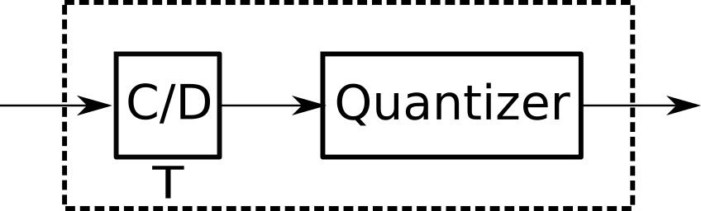
Problem Formulation
What is a Sampling Rate ?
4/25

Slide 5
Problem Formulation
Most of modern signal processing chains are interconnection of systems operating at different rates
Need same sampling rates
Sampling rate conversion is crucial
Trade-off between quality and complexity
5/25

Slide 6
Problem Formulation
Current solution : plugin GStreamer
6/25

Slide 7
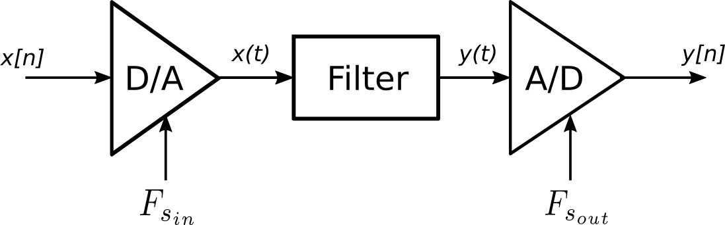
Approaches
SRC performed in continuous- and discrete-time domains
Signal distortion introduced by the D/A and A/D converters
Make interconnection simpler and more flexible
Conversion carried out entirely in the discrete-time domain
7/25

Slide 8
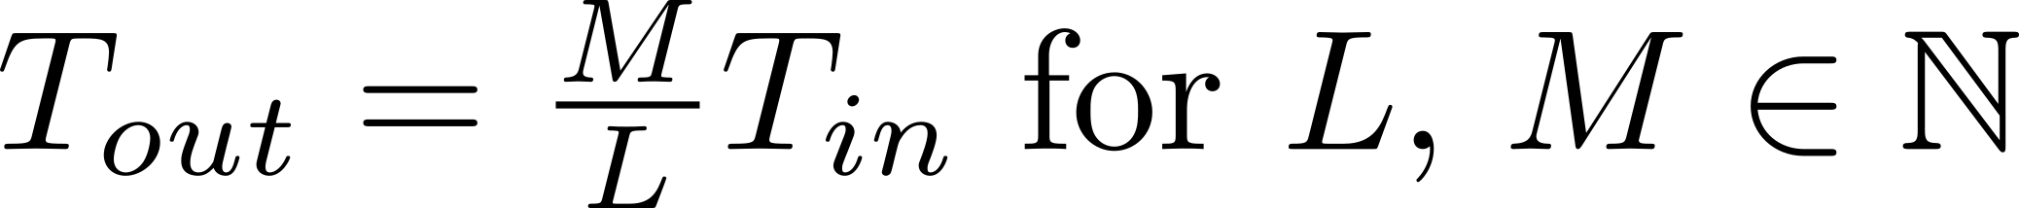
Approaches
Classification: synchronous and asynchronous SRCs
Synchronous
Single master clock
Different rates of the system related by a fixed factor
Rational number:
Asynchronous
Several separate clocks operating at different rates
SR related by an arbitrary factor
Can vary over time
8/25
Notes:
SRConversion in the discrete-time domain classified into synchronous and asynchronous
Definitions inspired by the clock configuration setting the rates of the system
Synchronous: Assumption 2 first arrows
Considered to be a rationnal factor
Asynchronous example: USB audio device that receives data from a PC and then converts it to analog. The PC is sending audio based on its own clock rate while the D/A converter in the SUB device as a separate clock. Clocks are distinct are slowly vary over time

Slide 9
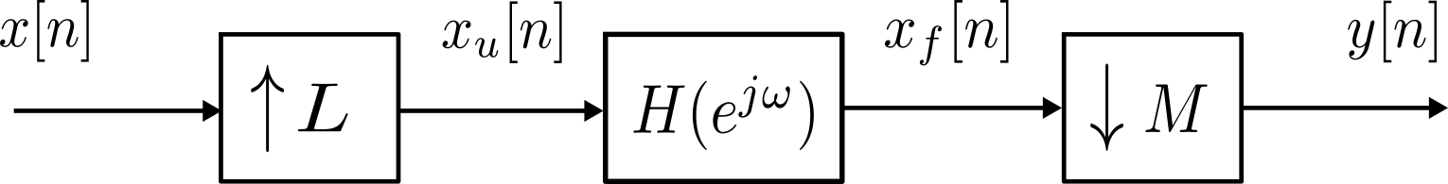
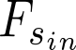
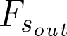
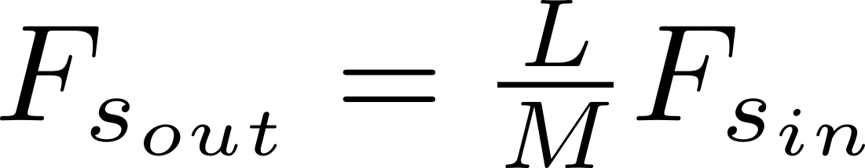
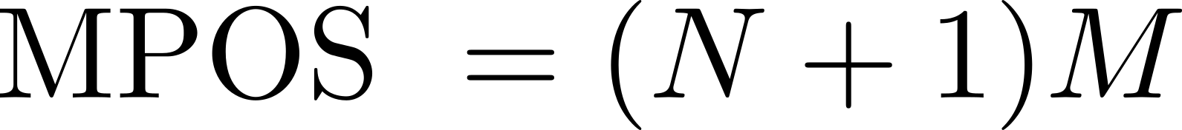
Approaches – Synchronous Conversion
Expander
Lowpass Filter
Decimator
New Sample Rate:
Efficiency measured in terms of MPOS
Direct implementation:
First concern: reducing the order
9/25
Notes:
View with processing in discrete time
Insert L-1 0s between each of the original samples -> LPF (at half of the lower of the two rates) and select every M-th sample from the filtered output

Slide 10
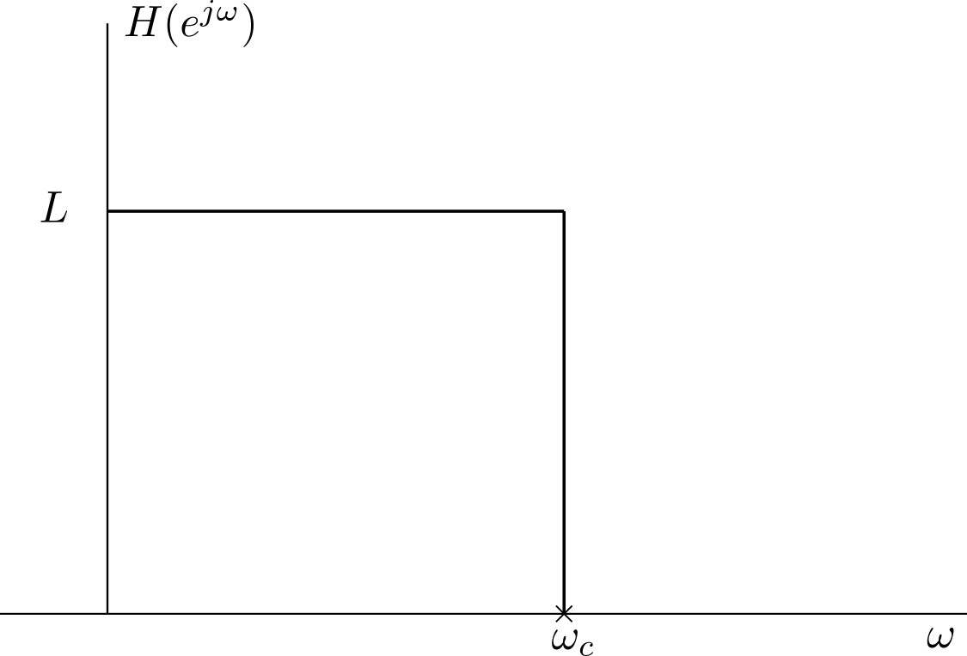
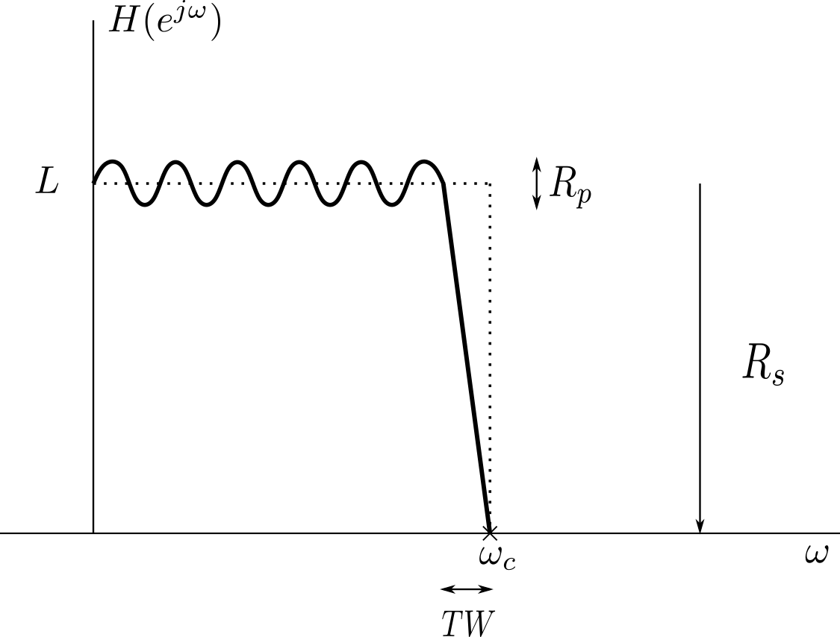
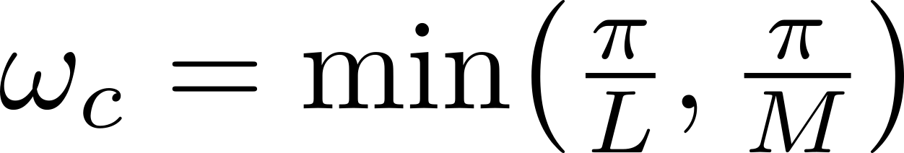
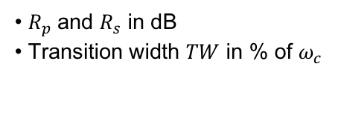
Approaches – Filter
Filter Design
Need good approximation of an ideal low-pass filter
•
• gain of L
• $R_{p}$and $R_{s}$ in dB
• Transition width $TW$ in % of $ω_{c}$
10/25

Slide 11
Approaches – Choice of Filter
Audio applications: tendency to use linear phase filters
Psychoacoustic effects are uncertain
Retained two filters
Parks-McClellan Filter
Elliptic Filter
FIR
IIR
Linear phase
Non-linear phase
High order
Low order
11/25

Slide 12
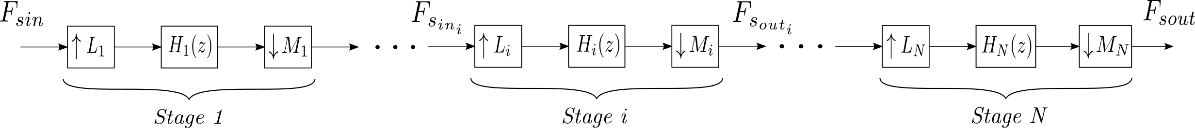
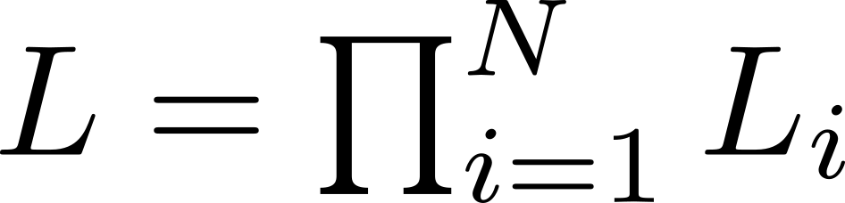
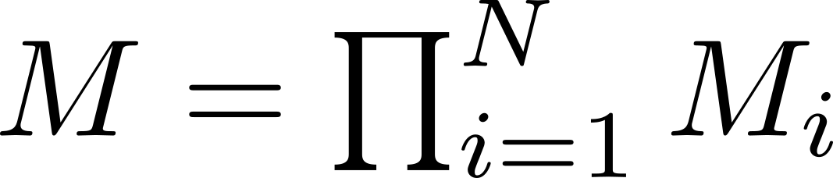
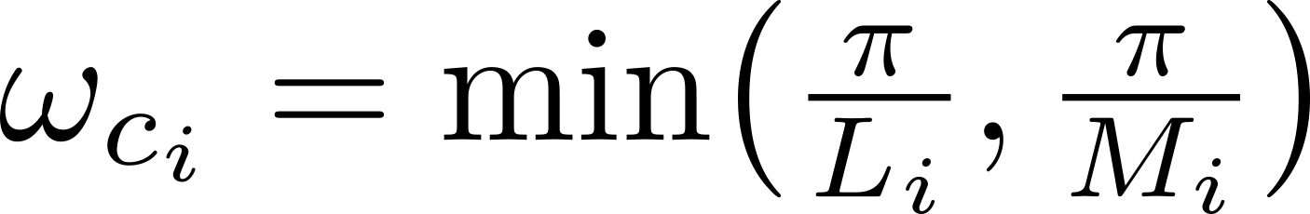
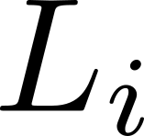
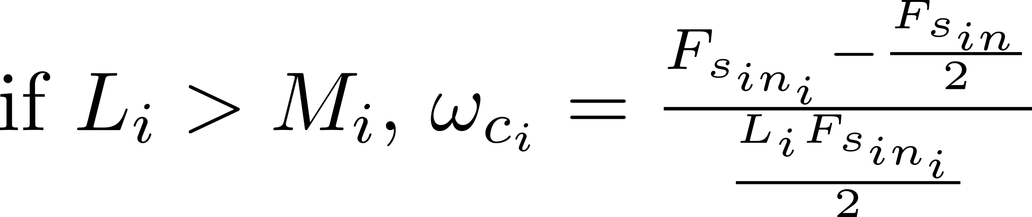
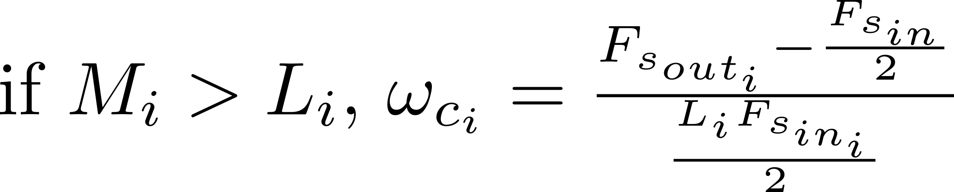
Approaches - Multistage
2 methods investigated :
• Classic method : -
- gain of
• “Second” method [1]: - gain of
- Cutoff: - ,
-
[1] R. E. Crochiere and L. R. Rabiner. “Optimum FIR Digital Filter Implementation for Decimation, Interpolation, and Narrow-Band Filtering”. Transactions on Acoustics, Speech, and Signal Processing (Volume: 23 , Issue: 5 , Oct 1975)
12/25
Notes:
Second method use in Smarc

Slide 13
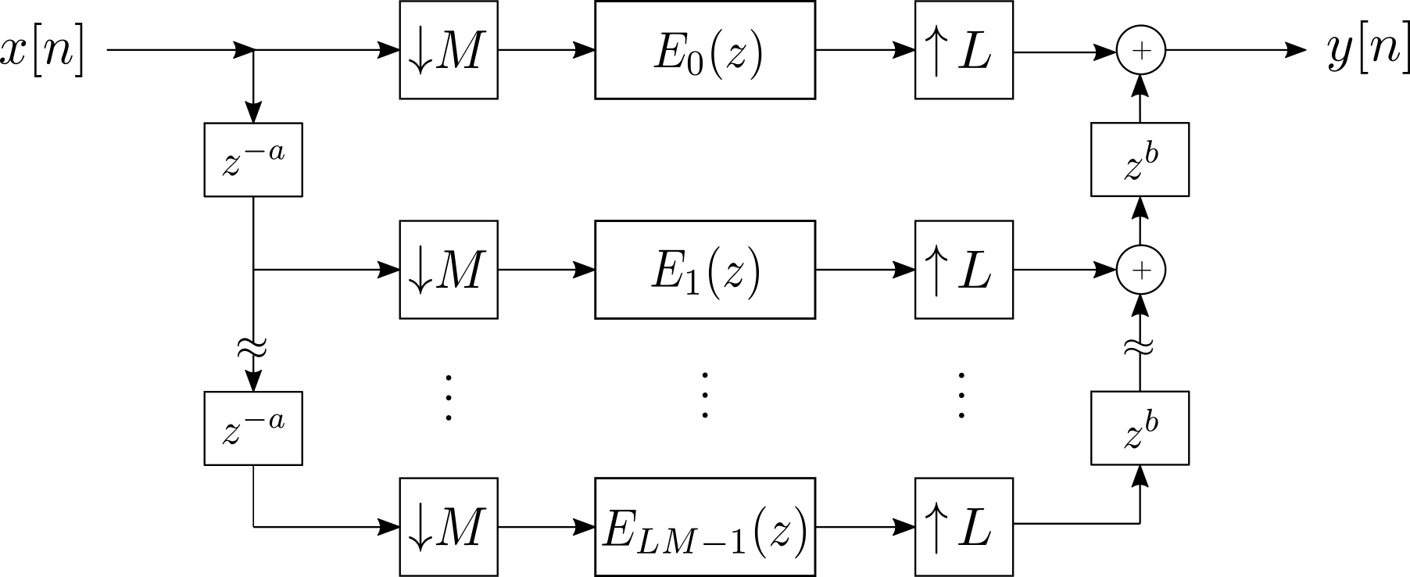
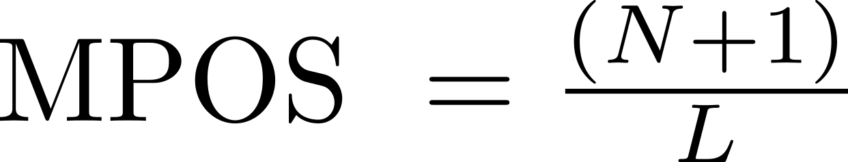
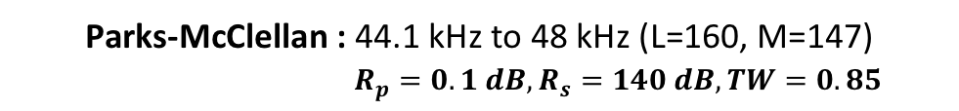
Approaches - Polyphase
Second concern: arranging the computation
1.a) Polyphase for FIR
Reduce the cost of computation :
Parks-McClellan : 44.1 kHz to 48 kHz (L=160, M=147)
$R_{p}=0.1 dB, R_{s}=140 dB, TW=0.85$
MPOS = 68.7
13/25

Slide 14
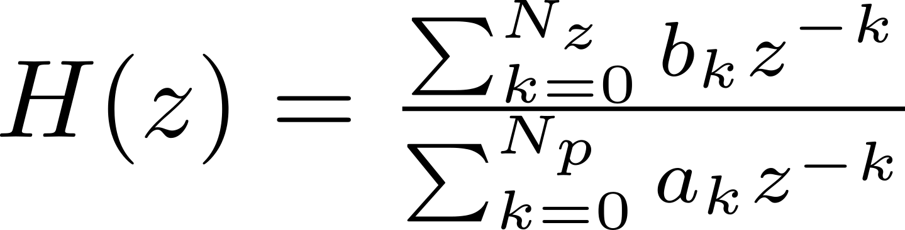
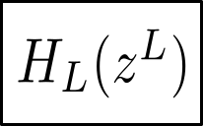
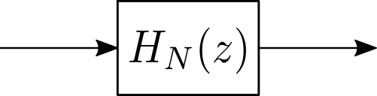
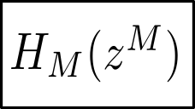
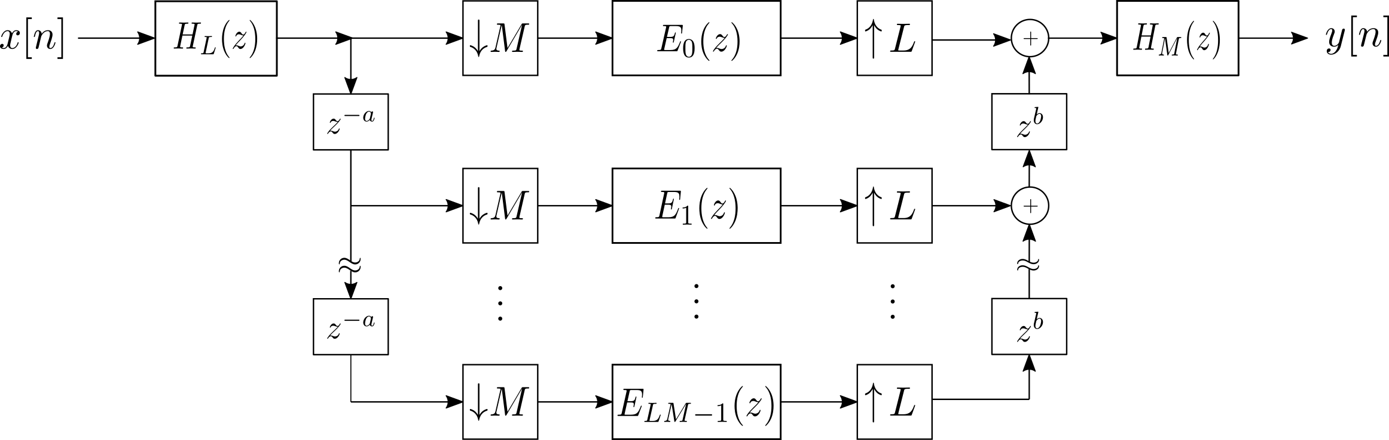
Approaches - Polyphase
1.b) Polyphase for IIR [2]
MPOS = 30.7063
[2] A. I. Russell. “Efficient Rational Sampling Rate Alternation Using IIR Filters”. IEEE Signal Processing Letters
(Volume: 7 , Issue: 1 , Jan. 2000)
14/25

Slide 15
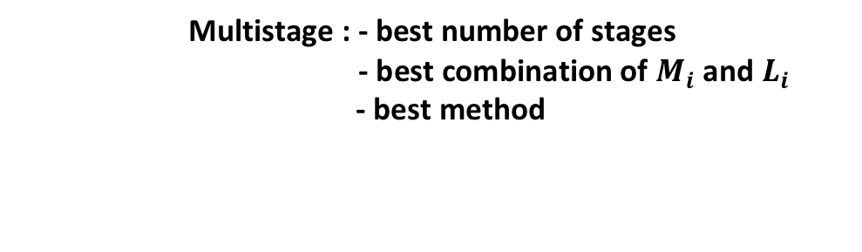
Results
Special Case : Conversion from 44.1 kHz to 48 kHz (L = 160; M = 147)
3 Considerations : • Parks-McClellan Folded structure
• A. Russell Elliptic structure
• Combination Minimum-phase filters (Schuessler filters)
Multistage : - best number of stages
- best combination of $M_{i}$ and $L_{i}$
- best method
Polyphase
15/25

Slide 16
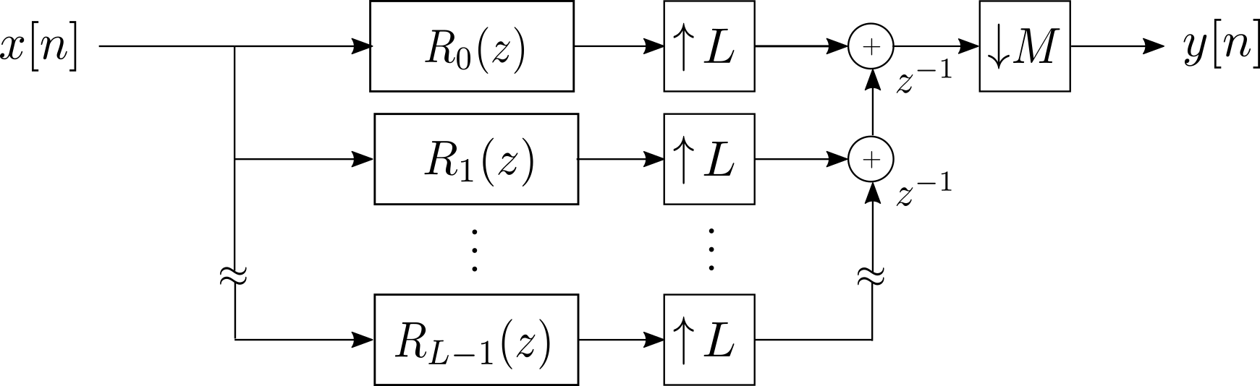
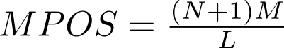
Results
Unfortunate mistake
16/25

Slide 17
Results
Multistage : classic method
Specifications : $R_{p}=0.1 dB, R_{s}=140 dB, TW=0.85$
Number of Stages | Filter Structure
 | Parks-McClellan Folded | Elliptic Russell
1 | 34.35 | 30.7063
2 | 64.1714 | 52.2545
3 | 66.3476 | 60.1405
4 | 66.8673 | 64.5922
5 | 68.9316 | N/A
6 | 70.8432 | N/A
Number of Stages | Filter Structure
 | Parks-McClellan Folded | Elliptic Russell
1 | 5048.9906 | 30.7063
2 | 738.6 | 52.2545
3 | 310.4333 | 60.1405
4 | 255.9408 | 64.5922
5 | 261.3568 | N/A
6 | 265.9228 | N/A
Importance of the arrangement of the stage factors
17/25

Slide 18
Results – Extra Comparison
Combination : Elliptic (Russell) + 3 minimum-phase filters (Schuessler Filters) [3]
Halving the degree while maintaining the same specifications
For the same filter’s specs: MPOS = 129.2269
Four-stage folded Parks-McClellan: MPOS = 255.9408
[3] D.I. Turek, “Design of Efficient Digital Interpolation Filters for Integer Upsampling”, MA thesis, M.I.T., Jun. 2004
18/25

Slide 19
Results
• One-stage folded Parks-McClellan
• One-stage Elliptic (Russell)
19/25

Slide 20
Results
• Combination elliptic (Russell) + 3 Schuessler filters
20/25

Slide 21
Results
Multistage method
Classic method used in previous cases
Second Method ?
four-stage folded Parks-McClellan (0.1, 140, 0.85)
MPOS = 172.4075
instead of 255.9408: reduction by nearly 1.5
21/25

Slide 22
22/25

Slide 23
Results
Final Choice
Features | Filter Structure
 | Parks-McClellan Folded | Elliptic Russell
Polyphase Decompostion | Yes | Yes
Multistage Method | None | None
Number of Stages | 1 | 1
MPOS | 34.35 | 30.7063
23/25

Slide 24
Future Work
Proceed with the assessement of the audio quality of retained solutions
Effect of the global phase distortion and impulse response
Insert solutions in Gstreamer plugin
Block-based processing (overlap-add/save methods)
24/25

Slide 25
Thank You!
Questions?
25/25

